Slide 1
Introduction to Programming Applications with Python
By: Iman Khani Jazani
- Senior Data Scientist, Adin - Technical AI Product Manager and Advisor, Mehra - Adjunct Professor, Sharif University of Technology

Slide 2
Today
Course Information
Discussion about Python in Research and Industries
Chapter 1 (How to Think Like a Computer Scientist Learning with Python 3)

Slide 3
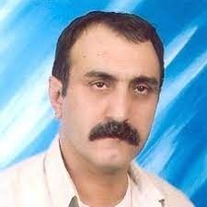
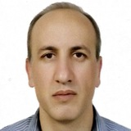
MANY Thanks to…
Dr. Abbas Nowzari
Associate Professor, Tehran University
Dr. Mohammad Ganjtabesh
Associate Professor, Tehran University

Slide 4
Course Information

Slide 5
Grading
Approx. 20% Programming Assignments
Approx. 2% Challenging Questions and Contributions in Class
Approx. 13% Mid-term Project (alone)
Approx. 35% Final Project (team work~5 member)
Proposal (about real needs)
Coding
Release
Approx. 30% Final Exam
Approx. 5% Presentation with Code(extra score)

Slide 6
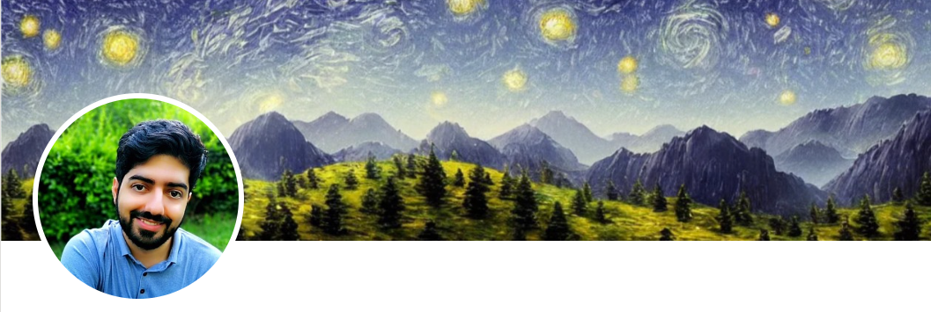
Contact me
Gmail: ImanKhaniJazani@gmail.com
LinkedIn: https://www.linkedin.com/in/ImanKhaniJazani/
Telegram: @IKJ1992

Slide 7
Main links for our class
Telegram group: t.me/SharifPythonSpace1401
Github organization: github.com/SharifPythonSpace

Slide 8
Together
Send your feedback about the class whenever you want!

Slide 9
Course plan
Fundamental concepts in computer science
Algorithm thinking
Coding with Python
Some meetings with Python experts in different domain (may be)

Slide 10
Be in path
Programming Language
Knowledge of Concepts
Algorithm Thinking

Slide 11
TAs plan
?

Slide 12
What is Computation?

Slide 13
Lecture Resources

